Slide 1

Manufacturing Information System (MIS)
Plant 1 Yoyo (Bang Phi)

Slide 2
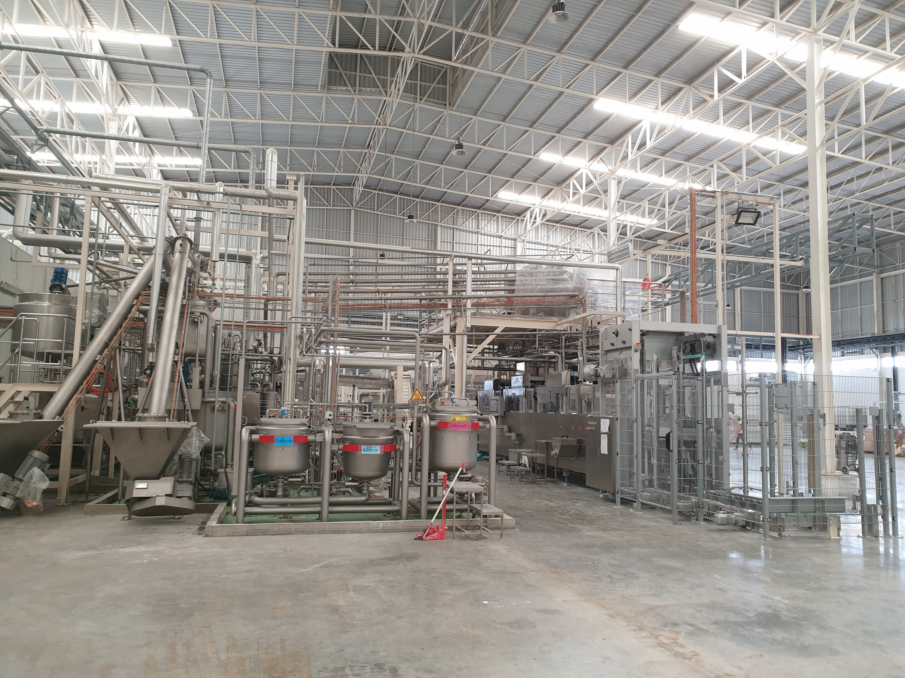
Plant 1 Yoyo
Page 1

Slide 3
Process Flow Diagram
Page 2
Chocotech
WDS
Drying
Oiling + Metal Detector
Wrap
Fuji 1
Fuji 2
Fuji 3
Fuji 4
Fuji 5
Fuji 6
Pack
Rui No.1
FW7 No.2
FW7 No.3
Kawa No.10
Pack Carton

Slide 4
Production Capacity/Utilization
Page 3
Production Capacity/Utilization
DRY
Wrap
Chocotech
WDS
Pack

Slide 5
Production Capacity/Utilization
Page 3.1
Chocotech + WDS
Capacity of M/C
Utilization of M/C
Week No | = | Chocotech + WDS | Production Out Put | = | Ton
 |  |  | M/C Utilization | = | %

Slide 6
Production Capacity/Utilization
Page 3.2
Dry
Capacity of M/C
Utilization of M/C
Week No | = | Dry Room | Production Out Put | = | Ton
 |  |  | M/C Utilization | = | %

Slide 7
Production Capacity/Utilization
Page 3.3
Wrap
Capacity of M/C
Utilization of M/C
Week No | = | Fuji No. 1 - 6 | Production Out Put | = | Ton
 |  |  | M/C Utilization | = | %

Slide 8
Production Capacity/Utilization
Page 3.4
Pack
Capacity of M/C
Utilization of M/C
Week No | = | Pack M/C | Production Out Put | = | Case
 |  |  | M/C Utilization | = | %

Slide 9
Plant Performance
Page 4
Plant Performance
Wrap
Chocotech + WDS
Pack

Slide 10
Plant Performance
Page 4.1
Week No. | =
Chocotech + WDS

Slide 11
Plant Performance
Page 4.2
Week No. | =
Wrap
Wrap
Wrap

Slide 12
Plant Performance
Page 4.3
Week No. | =
Pack

Slide 13
PM Plan/Actual Activity
Page 5
PM Plan
Wrap
Chocotech
Pack
WDS

Slide 14
PM Plan/Actual Activity
Page 5.1
Chocotech

Slide 15
PM Plan/Actual Activity
Page 5.2
WDS

Slide 16
PM Plan/Actual Activity
Page 5.3
Wrap

Slide 17
PM Plan/Actual Activity
Page 5.4
Pack

Slide 18
To Do List : Plant 1
Page 6
To Do List

Slide 19
To Do List : Plant 1
Page 6.1
To Do List
Updated On : 12 June 2020 (ล่าสุด)

